Slide 1
CSC1004 Tutorial 8 Weilin Cai

Slide 2
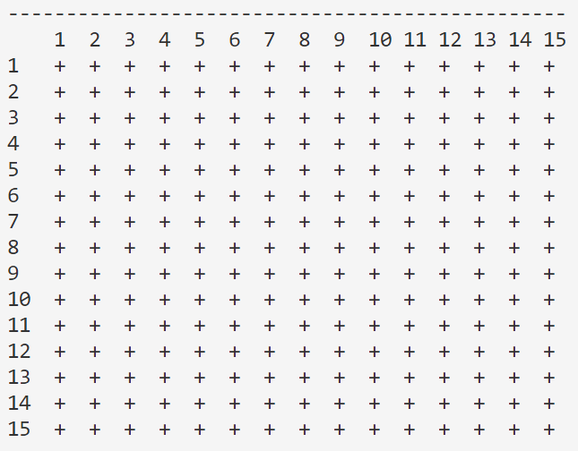
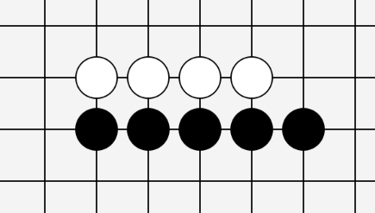
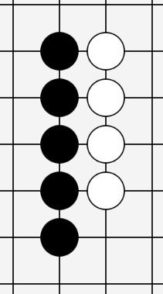
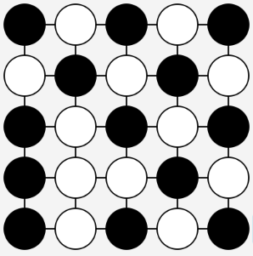
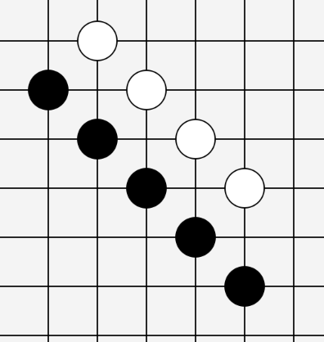
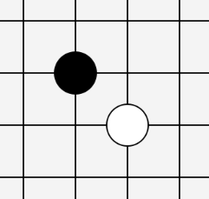
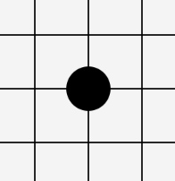
Gomoku Game (Recall)
Game Over
15×15 Chess Board
One Player Wins (Black in This Example)
A Draw (No One Wins)
(e.g. we
suppose
the board
is scaled
down
to be
5×5)
Horizontally
All positions for stones (chess)
are taken without reaching
the winning condition.
Black Plays First
Player 1, place first
No Overlap
vertically
Already Placed
It’s not allowed
to place a stone
on some existing
stone.
(Also, it’s not allowed
to place any stone
If the game is over)
Player 2,
place later
Five stones in a line
Gomo
(and the stones should be placed on the intersection of the lines of the board)
diagonally
五目

Slide 3
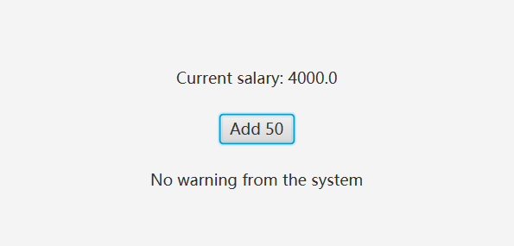
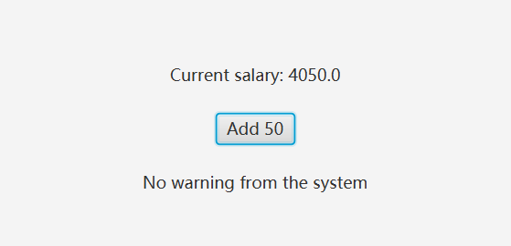
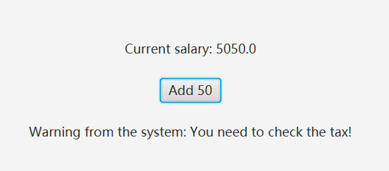
Changing Labels for Information
Salary Label Changed
Click
Keep Clicking …
Exceeds 5000 and not tax-exempt
Warning Label changed

Slide 4
Changing Labels for Information – Caller Maintenance
Source of Changes
Set Label Text Directly
SalaryV1.java
public class SalaryV1 {
private double basic;
private boolean taxExempt;
private String warningPrompt;
public SalaryV1(double basic, boolean taxExempt, String warningPrompt) {
this.basic = basic;
this.taxExempt = taxExempt;
this.warningPrompt = warningPrompt;
}
public double getBasic() {
return basic;
}
public void setBasic(double basic) {
this.basic = basic;
}
public boolean isTaxExempt() {
return taxExempt;
}
public String getWarningPrompt() {
return warningPrompt;
}
}
Need to know when to change the text
Change the text when the corresponding attribute is changed
The duty is maintained by the caller
You can copy these code and
execute it by yourself.

Slide 5
Changing Labels for Information – Caller Maintenance
public class CallerMaintain extends Application {
private SalaryV1 salary;
@Override
public void start(Stage primaryStage) throws Exception {
salary = new SalaryV1(4000, false, "You need to check the tax!");
VBox root = new VBox();
root.setAlignment(Pos.CENTER);
// info labels
Label currentSalaryLabel = new Label(getSalaryInfo());
Label permanentWarningLabel = new Label(getPermanentWarningInfo());
// add salary button
Button button = new Button("Add 50");
// bind the event
button.setOnMouseClicked(e -> {
salary.setBasic(salary.getBasic() + 50);
currentSalaryLabel.setText(getSalaryInfo());
permanentWarningLabel.setText(getPermanentWarningInfo());
});
root.getChildren().addAll(currentSalaryLabel, button, permanentWarningLabel);
// set margin
VBox.setMargin(currentSalaryLabel, new Insets(10));
VBox.setMargin(button, new Insets(10));
VBox.setMargin(permanentWarningLabel, new Insets(10));
// create scene
Scene scene = new Scene(root, 400, 200);
primaryStage.setTitle("Caller Maintain");
primaryStage.setScene(scene);
primaryStage.show();
}
private String getSalaryInfo() {
return "Current salary: " + salary.getBasic();
}
private String getPermanentWarningInfo() {
if (salary.getBasic() > 5000) {
if (salary.isTaxExempt()) {
return "Hint: You are tax exempted!";
} else {
return "Warning from the system: " + salary.getWarningPrompt();
}
} else {
return "No warning from the system";
}
}
public static void main(String[] args) {
launch(args);
}
}
Source of Changes
Set Label Text Directly
Need to know when to change the text
Change the text when the corresponding attribute is changed
The duty is maintained by the caller
CallerMaintain.java
You can copy these code and
execute it by yourself.
import javafx.application.Application;
import javafx.geometry.Pos;
import javafx.scene.Scene;
import javafx.scene.control.Button;
import javafx.scene.control.Label;
import javafx.scene.layout.VBox;
import javafx.stage.Stage;
import javafx.geometry.Insets;

Slide 6
Changing Labels for Information – Callee Maintenance
Notify the Observer to Update
SalaryV2.java
import javafx.beans.property.SimpleBooleanProperty;
import javafx.beans.property.SimpleDoubleProperty;
import javafx.beans.property.SimpleStringProperty;
class SalaryV2 {
private SimpleDoubleProperty basic;
private SimpleBooleanProperty taxExempt;
private SimpleStringProperty warningPrompt;
public SalaryV2(double basic, boolean taxExempt, String warningPrompt) {
this.basic = new SimpleDoubleProperty(basic);
this.taxExempt = new SimpleBooleanProperty(taxExempt);
this.warningPrompt = new SimpleStringProperty(warningPrompt);
}
public SimpleDoubleProperty getBasicProperty() {
return basic;
}
public double getBasic() {
return basic.get();
}
public void setBasic(double basic) {
this.basic.set(basic);
}
public SimpleBooleanProperty getTaxExemptProperty() {
return taxExempt;
}
public boolean isTaxExempt() {
return taxExempt.get();
}
public SimpleStringProperty getWarningPromptProperty() {
return warningPrompt;
}
}
bind
LabelText
Property
Source of Changes
Change
Property
Bind the property ahead of time
Change the property anytime you want
The label text is automatically changed
The duty is maintained by the callee

Slide 7
Changing Labels for Information – Callee Maintenance
Notify the Observer to Update
public class CalleeMaintain extends Application {
private SalaryV2 salary;
@Override
public void start(Stage primaryStage) throws Exception {
salary = new SalaryV2(4000, false, "You need to check the tax!");
VBox root = new VBox();
root.setAlignment(Pos.CENTER);
// info labels
Label currentSalaryLabel = new Label();
Label permanentWarningLabel = new Label();
// bind info
currentSalaryLabel.textProperty().bind(getSalaryInfoExpression());
permanentWarningLabel.textProperty().bind(getPermanentWarningExpression());
// add salary button
Button button = new Button("Add 50");
// bind the event
button.setOnMouseClicked(e -> {
salary.setBasic(salary.getBasic() + 50);
});
root.getChildren().addAll(currentSalaryLabel, button, permanentWarningLabel);
// set margin
VBox.setMargin(currentSalaryLabel, new Insets(10));
VBox.setMargin(button, new Insets(10));
VBox.setMargin(permanentWarningLabel, new Insets(10));
// create scene
Scene scene = new Scene(root, 400, 200);
primaryStage.setTitle("Caller Maintain");
primaryStage.setScene(scene);
primaryStage.show();
}
private StringExpression getSalaryInfoExpression() {
return Bindings.concat("Current salary: ", salary.getBasicProperty()); // not `salary.getBasic()`
}
private StringExpression getPermanentWarningExpression() {
return Bindings.when(salary.getBasicProperty().greaterThan(5000))
.then(Bindings.when(salary.getTaxExemptProperty())
.then("Hint: You are tax exempted!")
.otherwise(Bindings.concat("Warning from the system: ", salary.getWarningPromptProperty())))
.otherwise("No warning from the system");
}
public static void main(String[] args) {
launch(args);
}
}
bind
LabelText
Property
Source of Changes
Change
Property
Bind the property ahead of time
Change the property anytime you want
The label text is automatically changed
The duty is maintained by the callee
CalleeMaintain.java
import javafx.application.Application;
import javafx.beans.binding.Bindings;
import javafx.beans.binding.StringExpression;
import javafx.geometry.Pos;
import javafx.scene.Scene;
import javafx.scene.control.Button;
import javafx.scene.control.Label;
import javafx.scene.layout.VBox;
import javafx.stage.Stage;
import javafx.geometry.Insets;

Slide 8
Handle Things with Delay/Recurrence
TimelineExample.java
import javafx.animation.KeyFrame;
import javafx.animation.Timeline;
import javafx.application.Application;
import javafx.scene.Scene;
import javafx.scene.layout.StackPane;
import javafx.scene.shape.Circle;
import javafx.stage.Stage;
import javafx.util.Duration;
public class TimelineExample extends Application {
@Override
public void start(Stage primaryStage) {
Circle circle = new Circle(50);
// Create a Timeline
Timeline timeline = new Timeline(new KeyFrame(Duration.millis(500), e -> {
// Action to be performed every 500 milliseconds
circle.setRadius((circle.getRadius() + 8) % 100);
}));
timeline.setCycleCount(Timeline.INDEFINITE); // Run the animation indefinitely (by default: 1 cycle)
timeline.play(); // Start the animation
StackPane root = new StackPane();
root.getChildren().add(circle);
Scene scene = new Scene(root, 300, 250);
primaryStage.setTitle("JavaFX Animation Example");
primaryStage.setScene(scene);
primaryStage.show();
}
public static void main(String[] args) {
launch(args);
}
}
Timeline is a part of the JavaFX animation package that can be used to create animations by defining key frames and their durations. It's particularly useful for creating simple to complex animations by interpolating the values over time.

Slide 9
Handle Things with Delay/Recurrence
AnimationExample.java
import javafx.animation.AnimationTimer;
import javafx.application.Application;
import javafx.scene.Scene;
import javafx.scene.layout.StackPane;
import javafx.scene.shape.Circle;
import javafx.stage.Stage;
public class AnimationExample extends Application {
@Override
public void start(Stage primaryStage) {
Circle circle = new Circle(50);
// Create an AnimationTimer
AnimationTimer timer = new AnimationTimer() {
@Override
public void handle(long now) {
// Action to be performed in every frame
circle.setRadius((circle.getRadius() + 1) % 100);
}
};
timer.start(); // Start the timer
StackPane root = new StackPane();
root.getChildren().add(circle);
Scene scene = new Scene(root, 300, 250);
primaryStage.setTitle("JavaFX Timer Example");
primaryStage.setScene(scene);
primaryStage.show();
}
public static void main(String[] args) {
launch(args);
}
}
AnimationTimer is another way to create animations or perform tasks in a frame-wise manner. It's useful when you need to update or check something in every frame while keeping up with the screen's refresh rate.

Slide 10
Handle Things with Delay/Recurrence
PauseTransitionExample.java
import javafx.animation.PauseTransition;
import javafx.application.Application;
import javafx.geometry.Insets;
import javafx.geometry.Pos;
import javafx.scene.Scene;
import javafx.scene.control.Button;
import javafx.scene.control.Label;
import javafx.scene.layout.VBox;
import javafx.stage.Stage;
public class PauseTransitionExample extends Application {
@Override
public void start(Stage primaryStage) {
Button button = new Button("Show temp Hint!");
Label label = new Label();
VBox root = new VBox();
root.setAlignment(Pos.CENTER);
root.getChildren().addAll(button, label);
VBox.setMargin(button, new Insets(10));
VBox.setMargin(label, new Insets(10));
button.setOnMouseClicked(e -> {
double time = 1;
label.setText("I will disappear in " + time + " seconds!");
PauseTransition pause = new PauseTransition(javafx.util.Duration.seconds(time));
pause.setOnFinished(e1 -> label.setText(""));
pause.play();
});
Scene scene = new Scene(root, 200, 100);
primaryStage.setTitle("JavaFX Pause Transition Example");
primaryStage.setScene(scene);
primaryStage.show();
}
public static void main(String[] args) {
launch(args);
}
}
If you simply want to execute a task after a delay, PauseTransition can be an option. It's a part of the JavaFX animation package that waits for a specified duration before executing an action.

Slide 11
Handle Things with Delay/Recurrence
Choosing the Right Approach
Use Timeline when you want to create animations based on key frames and durations.
Use AnimationTimer for tasks that need to update or check something on every frame or want to create more complex animations that depend on the frame rate.
Use PauseTransition for a simple delay or pause in execution.
PauseTransition
Timeline
Animation

Slide 12
Handle Things with Delay/Recurrence
import javafx.geometry.Insets;
public class CallerMaintainPopUp extends Application {
private SalaryV1 salary;
@Override
public void start(Stage primaryStage) throws Exception {
salary = new SalaryV1(4000, false, "You need to check the tax!");
VBox root = new VBox();
root.setAlignment(Pos.CENTER);
// info labels
Label currentSalaryLabel = new Label(getSalaryInfo());
Label permanentWarningLabel = new Label(getPermanentWarningInfo());
Label temporaryWarningLabel = new Label();
temporaryWarningLabel.setStyle("-fx-text-fill: red;");
// add salary button
Button button = new Button("Add 50");
// bind the event
button.setOnMouseClicked(e -> {
salary.setBasic(salary.getBasic() + 50);
currentSalaryLabel.setText(getSalaryInfo());
permanentWarningLabel.setText(getPermanentWarningInfo());
if (salary.getBasic() > 5000 && !salary.isTaxExempt()) {
// Pop-up temporary hint
temporaryWarningLabel.setText(getTemporaryWarningInfo());
Timeline timeline = new Timeline(new KeyFrame(
Duration.seconds(1),
ae -> temporaryWarningLabel.setText(""))); // Set the label's text to empty after 1 seconds
timeline.play();
}
});
root.getChildren().addAll(currentSalaryLabel, button, permanentWarningLabel, temporaryWarningLabel);
// set margin
VBox.setMargin(currentSalaryLabel, new Insets(10));
VBox.setMargin(button, new Insets(10));
VBox.setMargin(permanentWarningLabel, new Insets(10));
VBox.setMargin(temporaryWarningLabel, new Insets(10));
// create scene
Scene scene = new Scene(root, 400, 200);
primaryStage.setTitle("Caller Maintain");
primaryStage.setScene(scene);
primaryStage.show();
}
private String getSalaryInfo() {
return "Current salary: " + salary.getBasic();
}
private String getPermanentWarningInfo() {
if (salary.getBasic() > 5000) {
if (salary.isTaxExempt()) {
return "Hint: You are tax exempted!";
} else {
return "Warning from the system: " + salary.getWarningPrompt();
}
} else {
return "No warning from the system";
}
}
private String getTemporaryWarningInfo() {
return "Salary " + salary.getBasic() + " is more than 5000 without tax exemption!";
}
public static void main(String[] args) {
launch(args);
}
}
import javafx.animation.KeyFrame;
import javafx.animation.Timeline;
import javafx.application.Application;
import javafx.geometry.Pos;
import javafx.scene.Scene;
import javafx.scene.control.Button;
import javafx.scene.control.Label;
import javafx.scene.layout.VBox;
import javafx.stage.Stage;
import javafx.util.Duration;
import javafx.geometry.Insets;
public class CalleeMaintainPopUp extends Application {
private SalaryV2 salary;
@Override
public void start(Stage primaryStage) throws Exception {
salary = new SalaryV2(4000, false, "You need to check the tax!");
VBox root = new VBox();
root.setAlignment(Pos.CENTER);
// info labels
Label currentSalaryLabel = new Label();
Label permanentWarningLabel = new Label();
Label temporaryWarningLabel = new Label();
temporaryWarningLabel.setStyle("-fx-text-fill: red;");
// bind info
currentSalaryLabel.textProperty().bind(getSalaryInfoExpression());
permanentWarningLabel.textProperty().bind(getPermanentWarningExpression());
// add salary button
Button button = new Button("Add 50");
// bind the event
button.setOnMouseClicked(e -> {
salary.setBasic(salary.getBasic() + 50);
if (salary.getBasic() > 5000) {
// Pop-up temporary hint
temporaryWarningLabel.setText(getTemporaryWarningInfo());
Timeline timeline = new Timeline(new KeyFrame(
Duration.seconds(1),
ae -> temporaryWarningLabel.setText(""))); // Set the label's text to empty after 1 seconds
timeline.play();
}
});
root.getChildren().addAll(currentSalaryLabel, button, permanentWarningLabel, temporaryWarningLabel);
// set margin
VBox.setMargin(currentSalaryLabel, new Insets(10));
VBox.setMargin(button, new Insets(10));
VBox.setMargin(permanentWarningLabel, new Insets(10));
VBox.setMargin(temporaryWarningLabel, new Insets(10));
// create scene
Scene scene = new Scene(root, 400, 200);
primaryStage.setTitle("Caller Maintain");
primaryStage.setScene(scene);
primaryStage.show();
}
private StringExpression getSalaryInfoExpression() {
return Bindings.concat("Current salary: ", salary.getBasicProperty()); // not `salary.getBasic()`
}
private StringExpression getPermanentWarningExpression() {
return Bindings.when(salary.getBasicProperty().greaterThan(5000))
.then(Bindings.when(salary.getTaxExemptProperty())
.then("Hint: You are tax exempted!")
.otherwise(Bindings.concat("Warning from the system: ", salary.getWarningPromptProperty())))
.otherwise("No warning from the system");
}
private String getTemporaryWarningInfo() {
return "Salary " + salary.getBasic() + " is more than 5000, check the tax!";
}
public static void main(String[] args) {
launch(args);
}
}
import javafx.animation.KeyFrame;
import javafx.animation.Timeline;
import javafx.application.Application;
import javafx.beans.binding.Bindings;
import javafx.beans.binding.StringExpression;
import javafx.geometry.Pos;
import javafx.scene.Scene;
import javafx.scene.control.Button;
import javafx.scene.control.Label;
import javafx.scene.layout.VBox;
import javafx.stage.Stage;
import javafx.util.Duration;
import javafx.geometry.Insets;
This time we don’t implement the game in the slides but give you some hints
You can use the example code and the materials we once provided in the former slides
Modify the original code using the hint we provide here
Complete code will be released when the submissions are checked
CallerMaintainPopUp.java
CallerMaintainPopUp.java

Slide 13

THANK YOU
林天麟 教授
香港中文大学（深圳）
机器人与人工智能实验室
WeChat: tinlunlam

